Slide 1
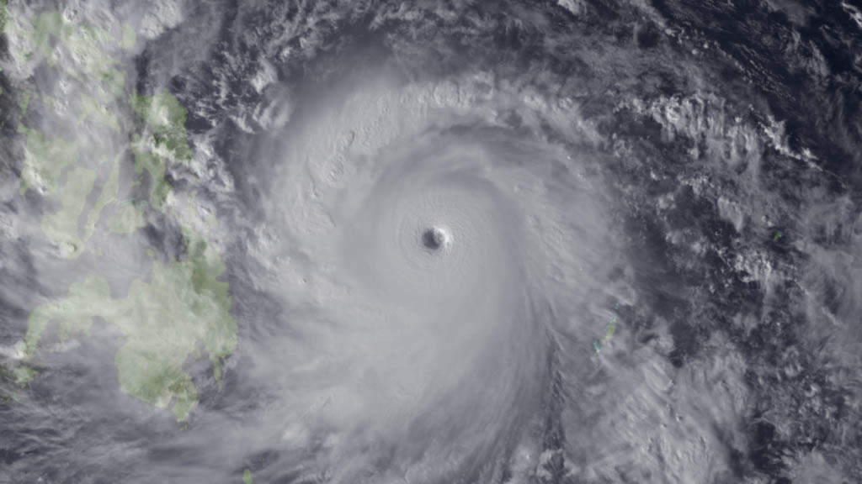
69th Interdepartmental Hurricane Conference
2015 Tropical Cyclone Research Forum
Typhoon Haiyan
Tropical Cyclone Operations and Research:
Setting our Future Course
March 1 – 5, 2015
Notes:
Leave this slide on the screen as the FC walks to podium

Slide 2
Forum Opening
Mr. David McCarren
Federal Coordinator for Meteorology (Acting)
69th Interdepartmental Hurricane Conference
2015 Tropical Cyclone Research Forum
Tropical Cyclone Operations and Research:
Setting our Future Course
The Office of the Federal Coordinator for
Meteorological Services and Supporting Research
(OFCM)

Slide 3
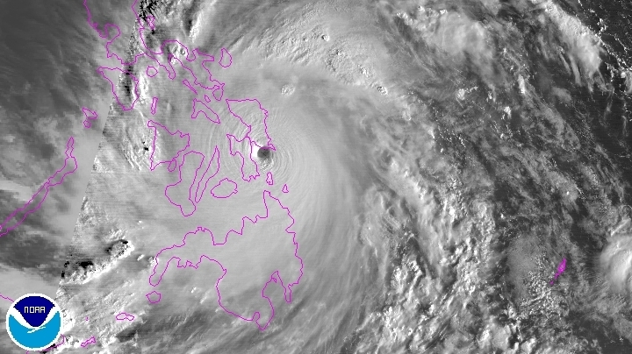
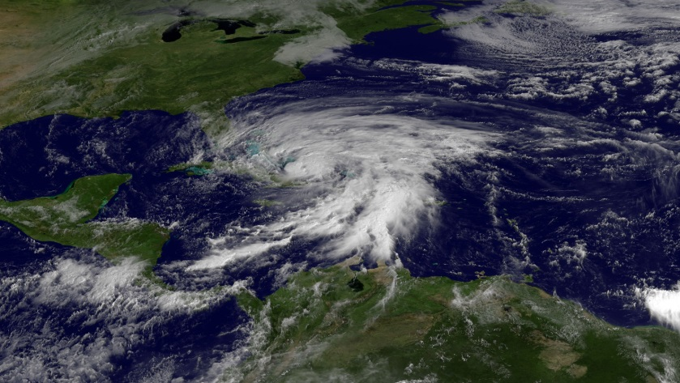
Reminder of Why Are We Here
Typhoon Haiyan, one of the most powerful storms in history. Yet we remember Sandy, Irene, Katrina, and so many others…
Typhoon Haiyan
We must continue to build upon the synergy and collaboration we’ve achieved in the tropical cyclone community since we developed the 2007 Interagency Strategic Research Plan for Tropical Cyclones: The Way Ahead to:
  Ensure we get the “biggest bang for the buck” in a tough budgetary climate
  Ultimately, minimize the Nation’s vulnerability to nature’s most destructive forces
Sandy
Hurricane Irene
Notes:
3
yphoon Haiyan (known as Typhoon Yolanda in the Philippines) devastated portions of Southeast Asia, particularly the Philippines, on November 8, 2013.
It is the deadliest Philippine typhoon on record, killing at least 6,201 people in that country alone.
Haiyan is also the strongest storm recorded at landfall, and unofficially the strongest typhoon ever recorded in terms of wind speed. As of January, 2014, bodies are still being found.
The thirtieth named storm of the 2013 Pacific typhoon season , the Joint Typhoon Warning Centre (JTWC) assessed the system as a Category 5-equivalent super typhoon.
Highest winds 10-minute sustained: 230 km/h (145 mph)
1-minute sustained: 315 km/h (195 mph)
Lowest pressure 895 mbar (hPa); 26.43 inHg (Estimated)
Fatalities 6,241 confirmed, 1,785 missing
Damage $1.5 billion (2013 USD) (Preliminary total)

Slide 4
Forum Goal
OFCM hosts an annual forum for the responsible Federal agencies, together with representatives from the academic research community, industry, and other user communities such as emergency management, to review the Nation's hurricane forecasting and warning program and to make recommendations on how to improve the program in the future.
In 2014, in lieu of the traditional Interdepartmental Hurricane Conference (IHC), the OFCM held a forum—the Tropical Cyclone Research Forum (TCRF)—with the goal of educating attendees on the status and future plans of the Nation's hurricane forecasting and warning program, particularly as they relate to tropical cyclone research programs and priorities.

Slide 5
Forum Goal
The primary focus of the 2015 TCRF/69th IHC will be to continue to evaluate the progress that has been made in implementing the 2007 Tropical Cyclone Forecasting Improvement Plan.
The principal action from the 2014 TCRF tasked the OFCM-sponsored Working Group for Tropical Cyclone Research (WG/TCR) to prepare an initial draft assessment of progress on the 2007 plan.
Based on the outcomes from the forum, the WG/TCR will then finalize and publish the assessment which will adjust our research priorities moving forward, as needed, and guide future Federal TC research activities in addressing the gaps in our capabilities.

Slide 6
Forum Agenda
Monday:
WG/HWSOR Meeting
Tuesday:
Opening Session
Session 1: The 2014 Tropical Cyclone Season in Review
Session 2: Research Priorities of the Operational Centers
Session 3: Transitioning Research to Operations
Poster Session/Ice Breaker

Slide 7
Forum Agenda
Wednesday:
Session 4: Observations and Observing Strategies,
Session 5: Advances in TC Model Development & Evaluation
Forum Luncheon
Thursday:
Session 6: The Future of the IHC—Agency Perspectives
Session 7: Products, Services, and Societal Impact
Session 8: TC Research Plan Mid-Course Assessment - Operational Needs and Research Priorities
Final Plenary Session

Slide 8
Special Acknowledgement
2015 TCRF/69th IHC Planning Team
Dr. Frank Marks
Dr. Ron Ferek
Dr. Sandy MacDonald
Dr. Edward Bensman

Slide 9
Conference Staff
Chair: Samuel P. Williamson / David McCarren
Forum Technical Director Assistant Director | Mr. Bob Dumont (OFCM/STC) Col Paul Roelle (Air Force / OFCM)
Forum Coordinator for Logistics | Ms. Erin McNamara (OFCM)
Webinar and Audiovisual | Mr. Ken Barnett (OFCM) Mr. Tony Ramirez (OFCM/STC)
Registrars | Ms. Erin McNamara (OFCM) Ms. Christina Bork (OFCM) Ms. Michelle McCambridge (UCAR)
Forum Coordinators | Mr. Bob Dumont (OFCM/STC) Mr. Michael Bonadonna (OFCM) Dr. Daniel Melendez (NWS)
Forum Rapporteurs | Mr. Floyd Hauth (OFCM/STC) Mr. Bob Dumont (OFCM/STC) Mr. Michael Bonadonna (OFCM) Dr. Daniel Melendez (NWS)
Notes:
9

